Slide 1


Realistic perturbation from ECMWF implied on an idealized hailstorm
Xiaofei Li
18/5/22 Email: lixiao1659@pku.edu.cn

Slide 2
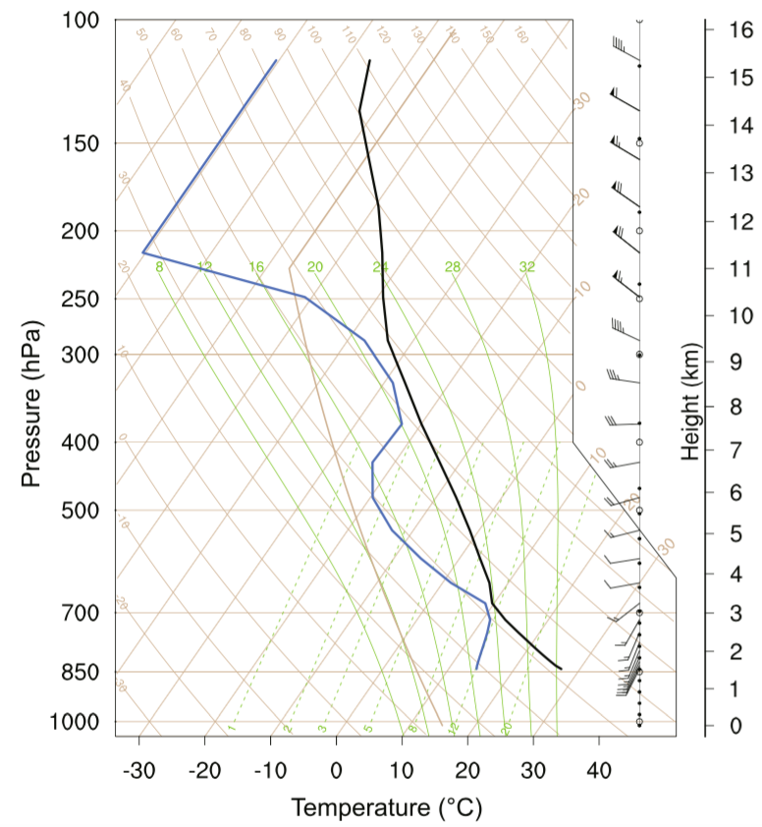
Basic sounding
Lifting condensation level | 701 hPa/ 11 ℃
Total precipitable water | 3 cm
CAPE | 1789 J/kg
Skew-T plots of the WRF real-time simulation sounding at 0600 UTC 29 June 2013, near Ordos, China.
(Li et al., 2017)
Notes:
The initial thermodynamic conditions for the simulations were given by this Skew-T profile, which is the same as my previous work on the CCN effect on hail. But this time, I am going to do some ensemble runs to study the of perturbed environmental conditions on hail. The idealized storm was triggered by a warm bubble in the lower layers.

Slide 3
STD of 50 perturbed soundings
Thanks Yue (Michael) Ying for data
Notes:
According to Fuqing’s suggestion, a realistic perturbation was implied. Thanks Michael for providing the data from ECMWF. The closest grid point with the nearest time was used. The differences between every member and the mean of all members was added to the basement sounding to set up 50 different members.

Slide 4
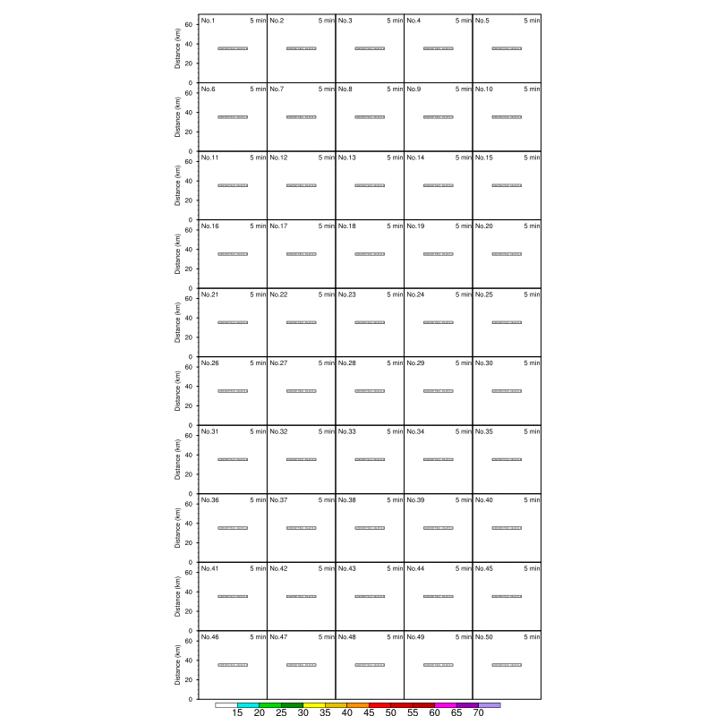
Results
Notes:
Then, let’s look at the firs result of the 50 runs. Different members show the different patterns of the radar reflectivity. To do a classification of the hail, I selected top 10 members and bottom 10 members by their hail precipitation rate.

Slide 5
Top 10 VS Bottom 10
Notes:
As this figure showed, top 10 members were marked by red lines, and bottom 10 were marked by blue lines. All the difference can be tracked down to the original difference, so that next I calculated the correlation between the precipitation and the initial soundings.

Slide 6
Correlation (Hail & precipitation VS initial soundings)
Notes:
Here, I calculated for both hail precipitation rate and total precipitation rate. The black dots represent a significance level below five percentage. Left four figures are for thermodynamics and the right four figures are for dynamics. It seems higher surface theta and lower theta at higher levels and a higher water vapor mixing ratio improve hail precipitation a lot, so does the total precipitation.

Slide 7
Top 10 VS Bottom 10
Notes:
So, I compared the difference of the initial four variables. It showed a consistent result with the former slide. That…….

Slide 8
Top 10 VS Bottom 10
Notes:
Vertical profiles of updraft velocity and microphysics latent heating averaged over the top 10 members and bottom 10 members during 30-60 min. We found that because of the differences in thermodynamics, top 10 lead to enhanced convections.

Slide 9
Top 10 VS Bottom 10
Notes:
So does every kind of hydrometeor. Top 10 enhanced quite a lot than the bottom 10. The right 4 figures show the hail increasing processes from the perspective of microphysics. that riming process, including collection of cloud and rain water, is quit important in hail increasing.

Slide 10
EC_All, EC_TQ, EC_UV,
EC_10%All, EC_10%TQ, EC_10%UV.
Notes:
next, I did some more ensemble runs, including the perturbation on thermodynamic and dynamic only as well as them reduced to 10%. All of the ensembles have similar or comparative ensemble mean while the ensemble spread performs quite different. It seems thermodynamics perturbation result in a wider spread than the dynamics perturbation both in 100% and 10%. and the 10% perturbation result in a less but non-linearized ensemble spread.

Slide 11
EC_All, EC_TQ, EC_UV,
EC_10%All, EC_10%TQ, EC_10%UV.
Notes:
the six hydrometeors performed a similar result with the previous slide. although there is detailed different in different kind of hydrometeor.

Slide 12
Correlation for 10%
Notes:
As for the correlation between precipitation and initial variables, the thermodynamic still has a strong correlation, due to a warmer surface, a cooler higher levels and more humidity. However, the top 10 in 100% perturbation is no longer the top 10 in 10% perturbation. so does the bottom 10.

Slide 13
Top 10 VS Bottom 10 for 10%
Notes:
As a result, the differences between the two groups is no longer as large as before.

Slide 14
Summary
Realistic perturbation implied on an idealized hailstorm is workable.
Hail is sensitive to the initial conditions, especially to thermodynamics.
The uncertainty of hail to the perturbation is non-linearized.

Slide 15
Thank you for listening！
Welcome questions and suggestions...
18/5/22 Email: lixiao1659@pku.edu.cn

